Slide 1

Should Stripe go Public in 2024?
By: Isaiah Sarria

Slide 2
Who is Stripe?

Slide 3

Background
Fintech company valued at about $65B
Founded by Patrick and John Collision in 2010
Payment processing, primarily
Also provides billing, invoicing, and sales tax automation services
Has been considering going public via an IPO

Slide 4
Stripe’s General Benefits
Business owners can accept credit, debit, and other forms of payments
The customer doesn’t need a contractual merchant account
Best suited for eCommerce (analytics and management)
Can integrate with in person point of sale systems without coding
Only initial hardware costs and payment processing fees

Slide 5
Stripe’s Payment Processing
Customer pays with a credit card
Stripe’s payment gateway encrypts card details (checks legitimacy, authorizes, and protects details)
Stripe as a merchant sends card details to an acquirer, a bank that will process the payment
The transaction is linked to credit card networks and the acquirer
When acquirer approves the transaction, it is no longer pending
Transaction listed on the customer’s credit card account

Slide 6

Stripe’s Payment Processing Fees
2.7% plus 5 cents for in-person transactions.
2.9% plus 30 cents for online transactions.
3.4% plus 30 cents for manually keyed transactions.
4.4% plus 30 cents for international card transactions.

Slide 7
Funding Rounds
Year | Raised Capital
2010 | $ 200,000.00
2011 | $ 2,000,000.00
2012 | $ 38,000,000.00
2014 | $ 100,000,000.00
2015 | $ 100,000,000.00
2016 | $ 316,000,000.00
2017 | $ 11,270,000.00
2018 | $ 283,500,000.00
2019 | $ 350,000,000.00
2020 | $ 600,000,000.00
2021 | $ 950,000,000.00
2023 | $ 65,000,000,000.00

Slide 8
Funding Rounds

Slide 9
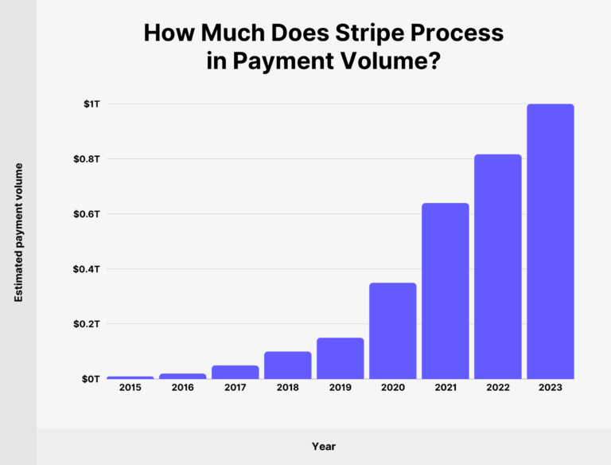
Notes:
Not number of transactions but the value of all those transactions combined

Slide 10
Stripe’s Company Worth
Notes:
Jumped back up last month

Slide 11

Some of the Competition
Size and Niche Comparisons

Slide 12
Competition Size Overview
 | Stripe | Paypal | Square
Valuation ($B) | 65.00 | 66.90 | 110.00
Annual Revenue ($B) | 14.40 | 29.80 | 21.90
Number of employees (K) | 8 | 27.2 | 12.9
Number of users (M) | 2.84 | 30 | 4
Year Founded | 2010 | 1998 | 2009

Slide 13

Stripe’s Niche and Clientele
Features geared towards online sales
High interface customizability for developers
Small businesses are main clientele
International support

Slide 14

PayPal vs Stripe
Small businesses are main clientele
Very recognizable international brand
Easy set up for teams without developers
Relatively higher price and monthly fees

Slide 15

Square vs Stripe
More point-of-sale (POS) support options and other service integrations
Low international support
In person businesses are main clientele
Relatively higher pricing and monthly fees

Slide 16

Stripe’s IPO Dilemma

Slide 17

What is an Initial Public Offering (IPO)?
“Going public” by selling shares on the stock market
A publicized market event
The publicity can increase company exposure, sales, and capital
Is a sign of stability and growth compared to a small private firm

Slide 18

Stripe’s Potential Reasons to be an IPO
Public investors want to invest
Private investments may only work for so long
Fintech 2022 IPO stocks are bouncing back
IPO activities is forecasted for second half of 2024
Would be a very prominent and established IPO
Dual class shares (more equity ownership ≠ more voting rights)

Slide 19

Stripe’s IPO Resistance
Prefer to be private because they feel young as a company
Reporting, legalities, costs, and appeasements when going public
Competitive player in the fintech market already
They privately sells stock to investors instead in funding rounds
Stripe employees can cash out private stock and IPO market slowed down in 2022

Slide 20
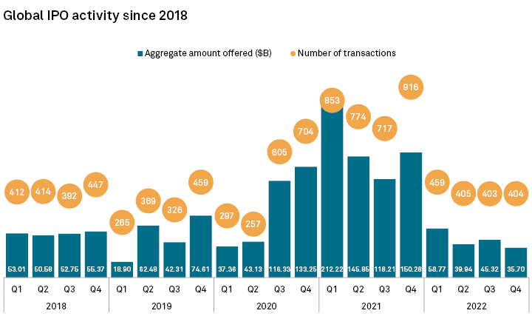
Notes:
Number of transactions is number of IPOs

Slide 21

Article Summary and Recap
IPO market was sluggish in 2022, so a rise is expected
Stripe considers an IPO for years, but remain private despite investor pressure
Stripe can maintain control after a potential IPO with dual-shares
Stripe is influential and has Uber, Google, and Apple partnerships
Stripe has many rivals in the merchant acquiring space but stays ahead with API
After rising back up from a valuation decline, Stripe will make an IPO choice this year

Slide 22
When should Stripe launch an IPO?
During stagnation and when competition is catching up before performance falls and investors lose faith
Enough time has passed to be seen as a very well-established firm (10 years is still relatively young)
The publicity is needed to attract or retain much needed talent
Stripe plans capital-heavy strategies, expansions, or innovations and could use the funding
If IPO market is active and one of the following apply:

Slide 23

Stripe should stay private in 2024
They are still a multibillion-dollar company
Able to enjoy private freedoms
Can use IPO launch as a trump card when needed

Slide 24

Questions?

Slide 25
Sources
https://www.investors.com/news/technology/stripe-ipo-will-fintech-finally-take-the-plunge-when-market-picks-up/
https://www.ig.com/en/shares/ipos/what-is-an-ipo#:~:text=An%20initial%20public%20offering%20(IPO)%20is%20one%20of%20the%20methods,the%20predicted%20demand%20for%20them.
https://www.nerdwallet.com/article/small-business/what-is-stripe
https://www.reuters.com/technology/stripe-valuation-jumps-65-bln-employee-share-sale-deal-wsj-2024-02-28/
https://www.cnbc.com/2021/11/23/stripe-very-happy-staying-private-https://www.spglobal.com/marketintelligence/en/news-insights/latest-news-headlines/global-ipo-activity-cut-nearly-in-half-in-2022-just-20-launched-in-us-during-q4-73793488co-founder-john-collison-says.html
https://backlinko.com/stripe-users

